Slide 1

Git/GitHub

Slide 2

TABLE OF CONTENTS
01
02
03
04
version control
Git/GitHub
Using GitHub
Working together

Slide 3

What is a version control?
A version control system records the changes made to our code over time in a special database called repository.

Slide 4

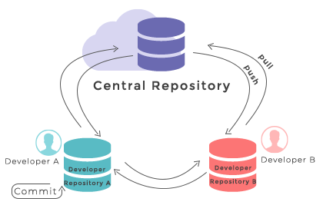



What is a repository?
A place to store your code and your changes to code, and it’s hosted on the cloud or in the web (GitHub)

Slide 5

Git
Version control system.
Track changes
historical backup
Teamwork
Trunk-based
development
Flexible

Slide 6
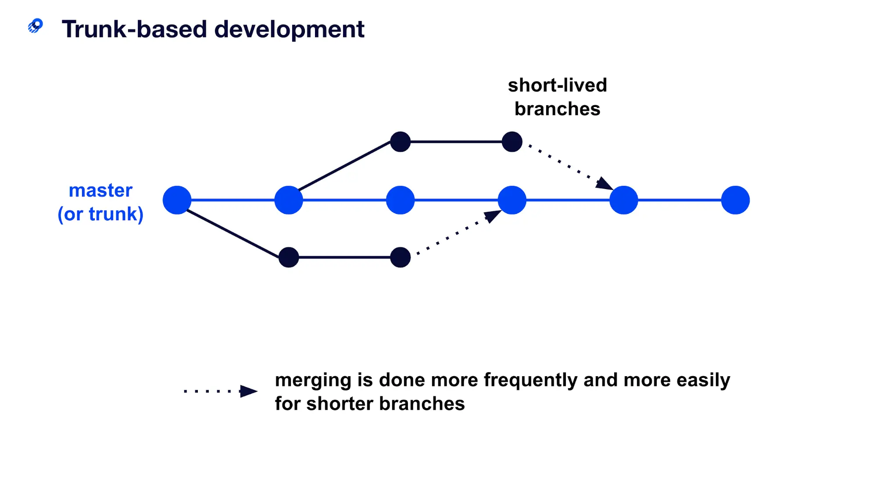
Trunk-Based development

Slide 7

The diffrenece
Git
GitHub
distributed version control system: tracking changes in any set of files, usually used for coordinating work among programmers collaboratively developing source code during software development.
Internet hosting service for software development and version control using Git.

